Slide 1



X
Business Performance Analysis
Kimia Farma - Big Data Analytics
Presented by
Norma Desitasari

Slide 2




Insert your photo here
<Norma Desitasari>
<S.Kom>
Graduated in Information Technology at Brawijaya University. Have internship experience as a programmer at Panasonic Manufacturing Indonesia. Learned develop web-based projects, Excel and Data Visualization using Python and google looker. Interested in a career a Data Analyst or Web Developer
<Jakarta>
<normadesitasari03@gmail.com>
www.linkedin.com/in/norma-desitasari-82700a1b6/>

Slide 3

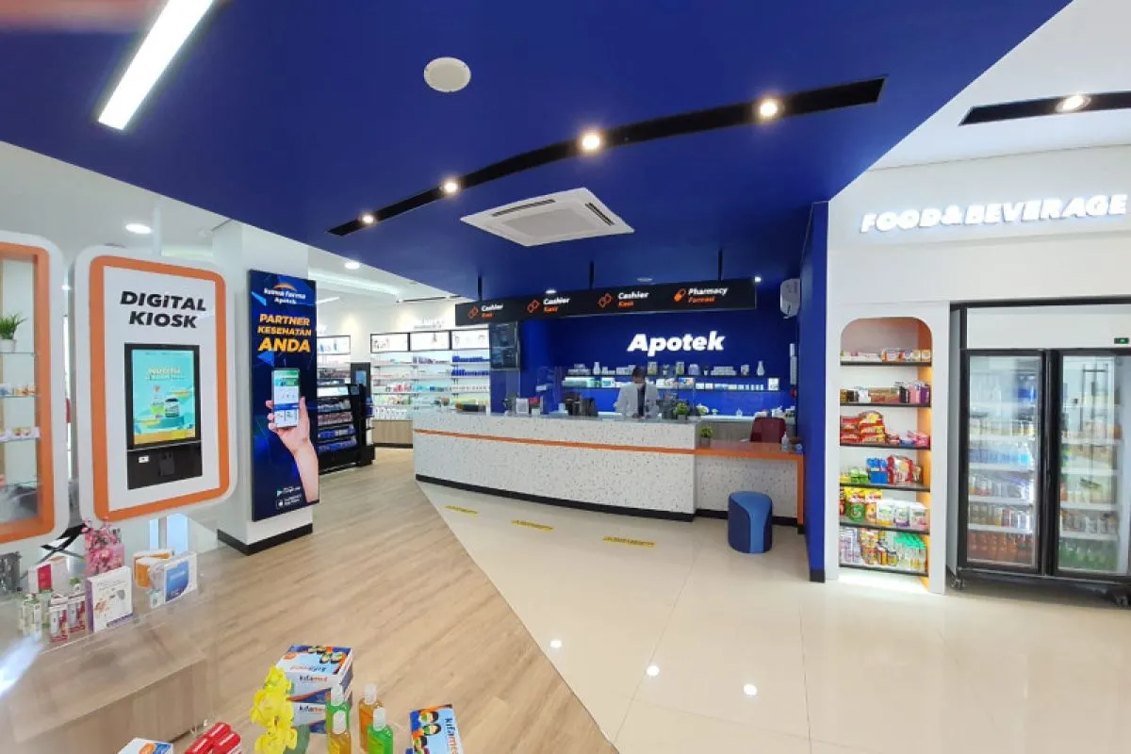
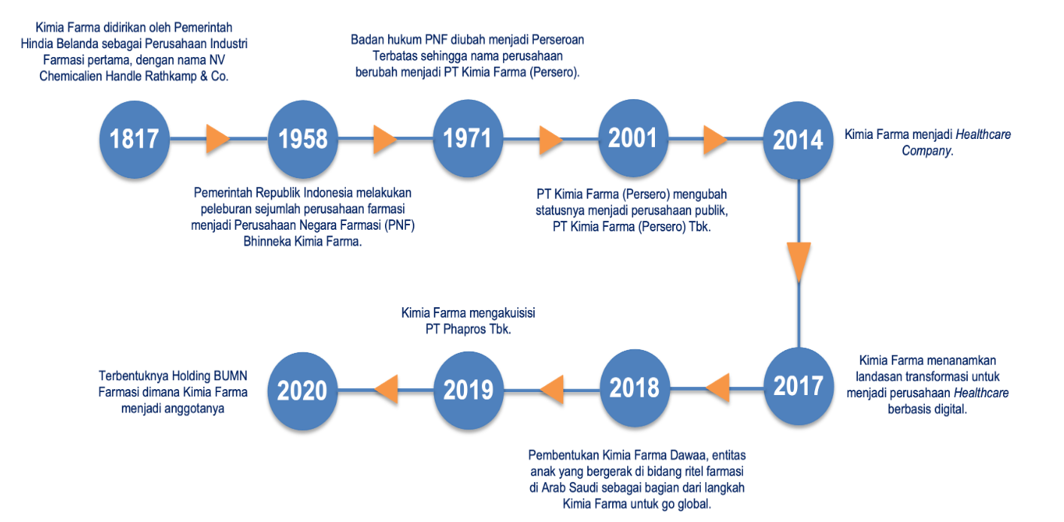

X
About Company

Slide 4
X
Project Portfolio
As a Big Data Analytics intern at Kimia Farma, I must have deep understanding of data and analytics skill.
The goals of this project is to evaluate the performance of Kimia Farmas’s business from 2020 to 2023 by creating analysis table and making dashboard as visual output.
Project explanation video here!
<buat hyperlink di kata "here" di atas, sisipkan link youtube yang berisi rekaman anda melakukan presentasi penjelasan hasil pengerjaan final task. Hapus pesan ini jika anda telah memahami pesan ini>

Slide 5


X
Tools

Slide 6
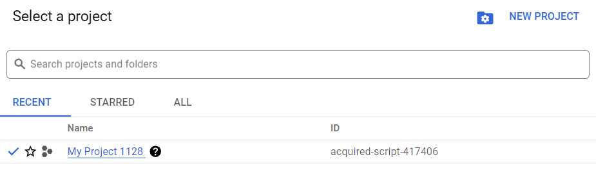
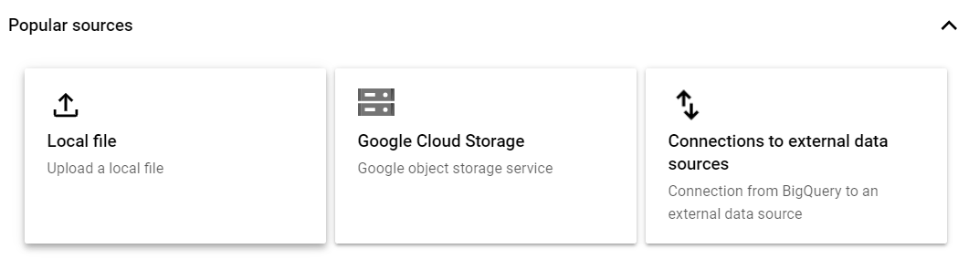

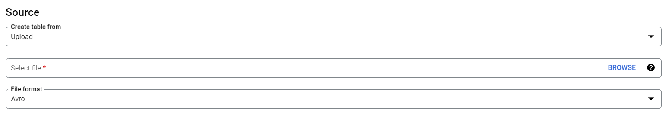
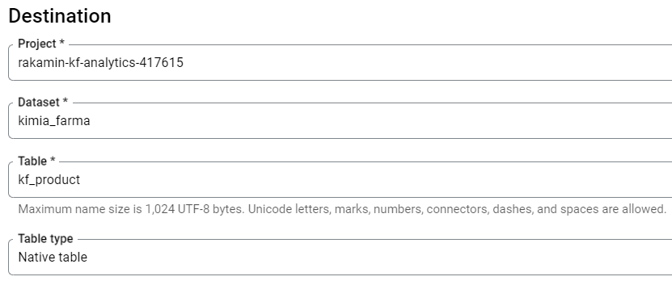
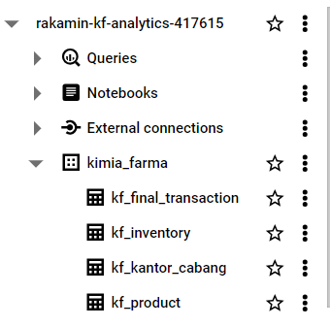

X
Importing Dataset to BigQuery
01
02
03
Go to bigQuery
Create new project
Add the file
04
05
Browse the file
06
Create dataset and named the table
Dataset
File has been created
Table

Slide 7
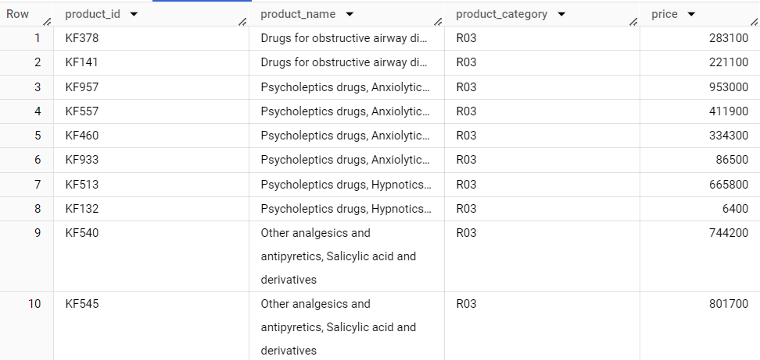
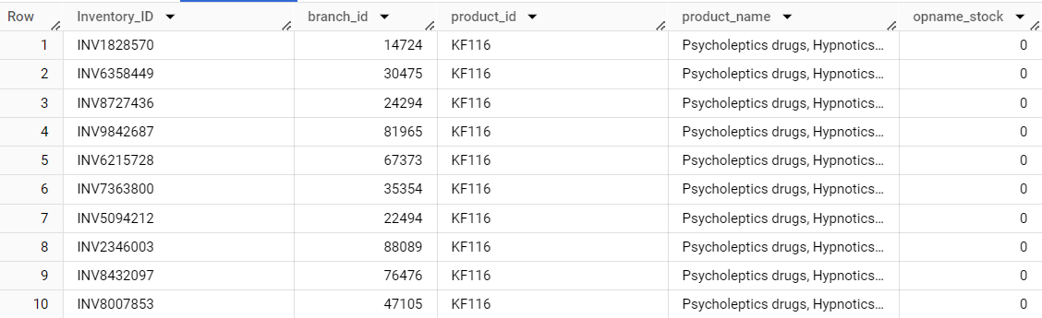
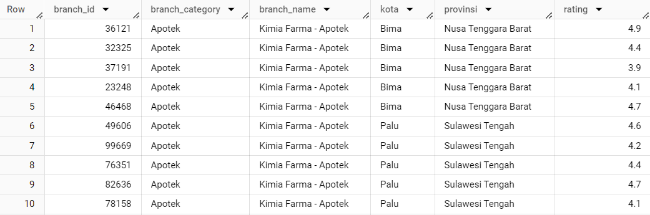
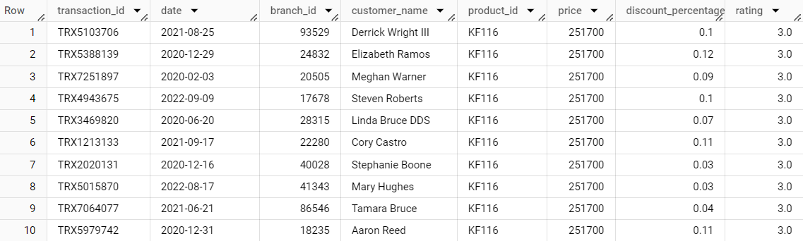
X
Dataset
Dataset Product
Dataset Inventory
Dataset Kantor Cabang
Dataset Final Transaksi

Slide 8
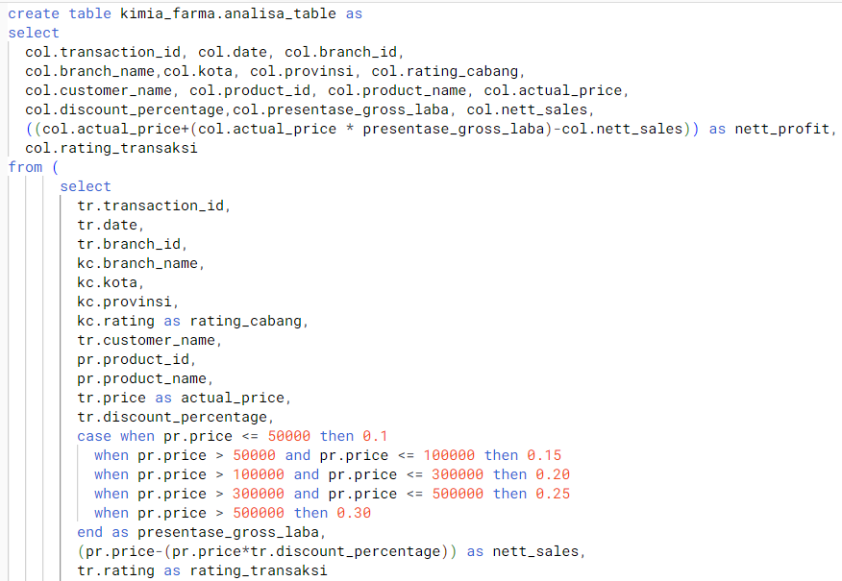
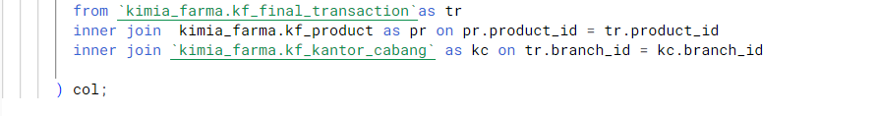
X
BigQuery Syntax

Slide 9
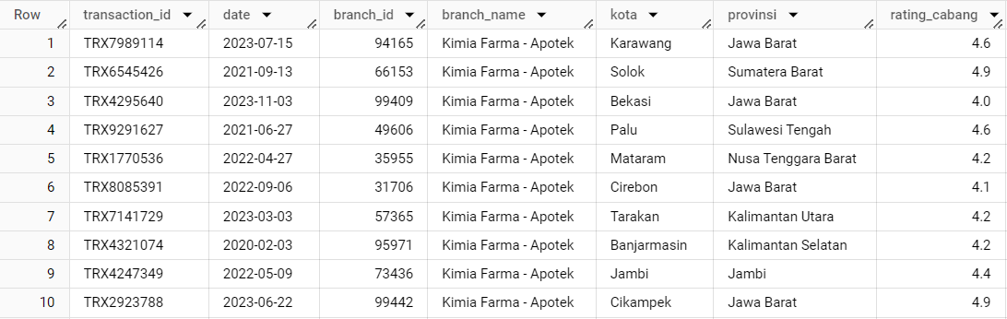
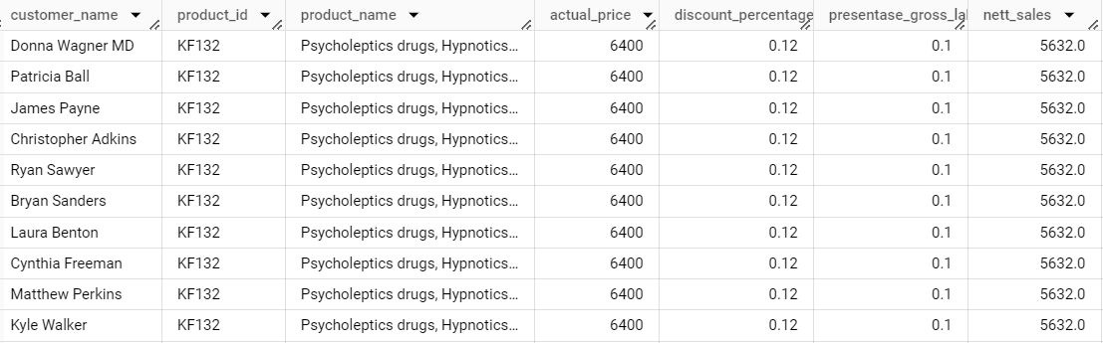
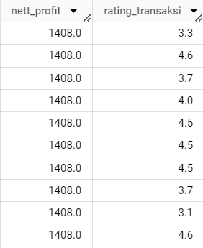
X
Aggregation Table

Slide 10
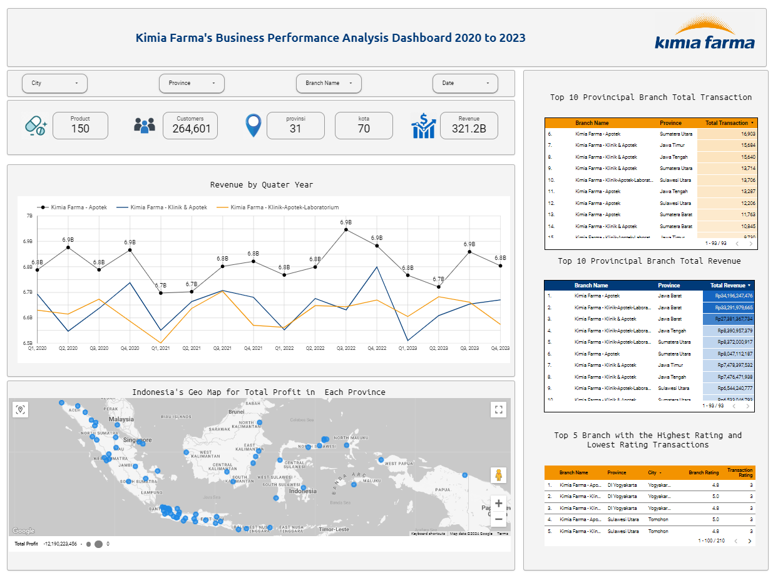
Dashboard Performance Analytics
X

Slide 11
Thank You
X
Logo Company

